Slide 1
VISUAL C#.NET session 8
Instructor: Edwin oduor

Slide 2

Quote of the day

Slide 3
Lesson objectives
String Manipulation
Converting text to Upper case
Converting Text to Lower Case
Checking for an Empty String
Index of Method
Contains Method

Slide 4
Lesson pre-requisites
In order to take full advantage of this section you need to have the following;
Computer with Visual Studio Installed.
Stable Network Connection.

Slide 5
Training methods and extra readings
TRAINING METHODS FOR THIS LESSON
EXTRA READINGS
Lecturing Method – This is the main method of training to be adopted in this lesson with illustrations and practical coding examples.
Discussion Method - This method will be adopted periodically whereby learning will be derived principally from the students brainstorming together, rather than from the trainer. Three main types of discussions will be used:
Directed discussion
Developmental discussion
Problem-Solving discussion
Home and Learn C#

Slide 6
String manipulation

Slide 7
WHAT is string manipulation

Slide 8
Just the way a puppeteer manipulates a puppet to what he or she wants the same concept applies here.
This is a concept whereby a programmer can manipulate what the user has entered into the textbox to the developer’s desired choice.
This is a concept in programming whereby the data entered in the text boxes has to be checked if the correct number of characters has been entered, check if a text box is empty or not, if the text entered has some space the concept of doing all this tasks is what is known as string manipulation.

Slide 9
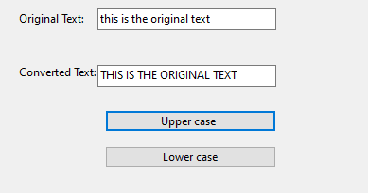
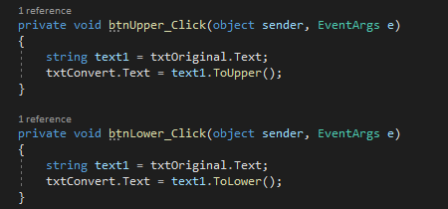
1. Converting text to upper & lower case
The first that we will work on is change a text from lower case to upper case and vice versa. For us to understand this we will be creating the simple system as shown (below) whereby when a button is clicked on then going to case the case from either upper or lower case. In this case the upper case button is clicked on so, its going to convert text to upper case.

Slide 10
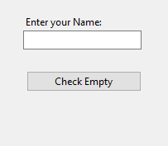
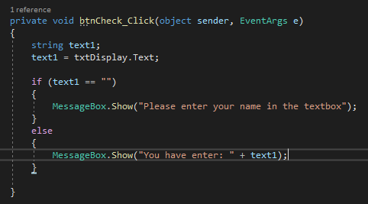
2. Check for empty textbox
The next is to check for an empty string using a textbox. In the system below if one clicks on the button and one has not entered their name in the textbox then a message will be displayed in a message box. “Telling the user to enter their name in the textbox”

Slide 11
2. Check for empty text box cont.
The problem with this code is that when a user clicks inside the text box and press the space bar on the keyboard then the second part of the message is going to be displayed and that is not what we want. The system will see space entered in the textbox as characters hence display the second message. To prevent this then we will use the trim method to trim the spaces in the textbox.

Slide 12
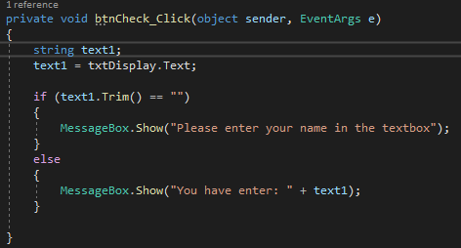
3. Trim method

Slide 13
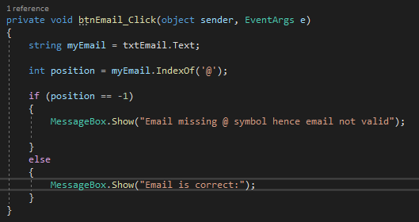
4. Index of
The index of method what this does it checks the position of a character or string and returns the position of the character or the string. On the other hand, if the position of the character in the string is not there then negative one (-1) will be returned.
In the code on the left we are checking the email entered in the text box to see if it has @ symbol if it does not have then the first message is displayed, if the @ symbol is in the text then the second email is executed.

Slide 14
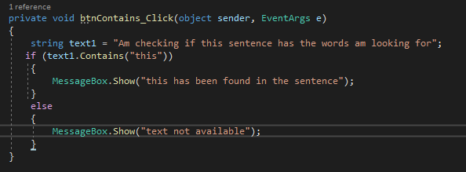
5. Contains method
This is a method that is used to check if a certain word or characters are in a given line of sentence. In the figure below we are checking to see if the sentence has “this”, if that is the case then the first message is going to be displayed and if it’s not in the sentence then the second message will be displayed.

